Slide 1
IPv6 Header & Extensions
Joe Zhao
SW2
Great China R&D Center
ZyXEL Communications, Inc

Slide 2
Outline
IPv4 header
IPv6 header
IPv4 header vs. IPv6 header
IPv6 extension header
IPv6 MTU & Checksum
Q & A

Slide 3
IPv4 header
Version | IHL | Type of Service | Total Length
Identification |  |  | Flags | Fragment Offset
Time to Live |  | Protocol | Header Checksum
Source Address
Destination Address
Options |  |  |  |  | Padding
IPv4 header, normally IPv4 header is 20 bytes length
Options is fixed length, 40 bytes
Notes:
1. Verify the Header Checksum field by performing its own checksum calculation and comparing its result with the result stored in the IPv4 header. ( modern high-speed routers commonly skip it)
2. Verify the value of the Version field. Doing so saves network bandwidth, as a packet containing an invalid version number is not propagated across the IPv4 internetwork only to be discarded by the destination node
3. Decrement the value of the TTL field. If its new value is less than 1, send an ICMPv4 Time Exceeded-Time to Live Exceeded in Transit message to the source of the packet and then discard the packet. If not, place the new value in the TTL field
4. Check for the presence of IPv4 header options. If present, process them
5. Use the value of the Destination Address field and the contents of the local routing table to determine a forwarding interface and a next-hop IPv4 address. If a route is not found, send an ICMPv4 Destination Unreachable-Host Unreachable message to the source of the packet and discard the packet
6. If the IPv4 maximum transmission unit (MTU) of the forwarding interface is less than the value of the Total Length field and the Don't Fragment (DF) flag is set to 0, perform IPv4 fragmentation. If the MTU of the forwarding interface is less than the value of the Total Length field and the DF flag is set to 1, send an ICMPv4 Destination Unreachable-Fragmentation Needed And DF Set message to the source of the packet and discard the packet
7. Recalculate the new header checksum and place its new value in the Header Checksum field
8. Forward the packet by using the appropriate forwarding interface

Slide 4
IPv6 header
Version | Traffic Class | Flow Label
Payload Length |  |  | Next Header | Hop Limit
Source Address
Destination Address
IPv6 header, 40 bytes length
Next Header fields is used to indicate the extension header type
Move the unusable fields to extension header
Notes:
1. Verify the value of the Version field. Although this step is not required by RFC 2460, doing so saves network bandwidth, because a packet containing an invalid version number is not propagated across the IPv6 internetwork only to be discarded by the destination node.
2. Decrement the value of the Hop Limit field. If its new value is less than 1, send an ICMPv6 Time Exceeded-Hop Limit Exceeded in Transit message to the source of the packet and discard the packet. If not, place the new value in the Hop Limit field.
3. Check the Next Header field for a value of 0. If 0, process the Hop-by-Hop Options header.
4. Use the value of the Destination Address field and the contents of the local routing table to determine a forwarding interface and a next-hop IPv6 address. If a route is not found, send an ICMPv6 Destination Unreachable-No Route To Destination message to the source of the packet and then discard the packet.
5. If the link MTU of the forwarding interface is less than (40 + the value of the Payload Length field), send an ICMPv6 Packet Too Big message to the source of the packet and discard the packet.
6. Forward the packet by using the appropriate forwarding interface.

Slide 5
IPv4 header vs. IPv6 header
IPv4 Header
IPv6 Header
Version | IHL | Type of Service | Total Length
Identification |  |  | Flags | Fragment Offset
Time to Live |  | Protocol | Header Checksum
Source Address
Destination Address
Options |  |  |  |  | Padding
Version | Traffic Class | Flow Label
Payload Length |  |  | Next Header | Hop Limit
Source Address
Destination Address
- field’s name kept from IPv4 to IPv6
- fields not kept in IPv6
- Name & position changed in IPv6
- New field in IPv6
Legend

Slide 6
IPv4 header vs. IPv6 header
Revised fields
  Payload length (extension + data) vs. Total length (header + data)
  Next headers (Extension Header or Transport) vs. Protocol type
  Hop Limit (no time concept) vs. TTL (Time To Live)
    Maximum number of links over which the IPv6 packet can travel before being discarded
New fields
  Traffic Class (vs. TOS)
    To support differentiated service
    Values are not defined by RFC. It is up to applications
  Flow Label
    In order to send a sequence of packets, source desires special handling by the intervening routers (unicast or multicast)
    Details are not defined by RFC. It is up to applications

Slide 7
IPv4 header vs. IPv6 header
Removed fields
  IHL fields
    In IPv4, the “Options” length is various (up to 40 bytes)
    In IPv6, the header is fixed (40 bytes), the length of the option header is included in payload length
  Checksum
    In IPv6, the link layer perform bit-level error detection for the entire IPv6 packet
    TCP, UDP & ICMPv6 checksum calculation becomes mandatory
  Fragment Offset, ID, Flag
    In IPv4, all of these fields are used for fragmentation
    In IPv6, the fragmentation is contained in Fragmentation Extension Header
    In IPv6, router no longer perform the fragmentation. Only the host sent packet perform fragmentation
    Fragmentation was considered CPU intensive processing

Slide 8
IPv6 extension header
Value (Decimal) | Header
0 | Hop-by-Hop Options header
6 | TCP
17 | UDP
41 | Encapsulated IPv6 header
43 | Routing header
44 | Fragment header
50 | Encapsulating Security Payload header
51 | Authentication header
58 | ICMPv6
59 | No next header
60 | Destination Options header

Slide 9
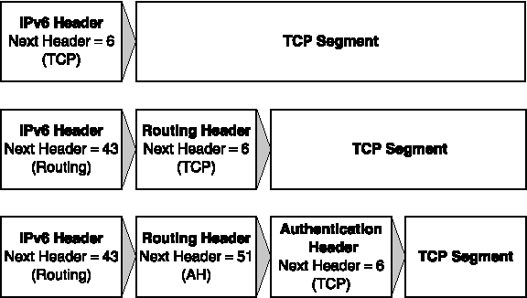
IPv6 extension header

Slide 10
IPv6 extension header
Hop-by-Hop Options header
  The Hop-by-Hop Options header is the only extension header is processed by every node on the path, it must be first
Destination Options header
  For intermediate destinations when the Routing header is present
Routing header
Fragment header
Authentication header
Encapsulating Security Payload header
Notes:
Destination Options header (for the final destination)

Slide 11
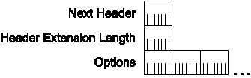
IPv6 extension header
Hop-by-Hop Options header
  The Hop-by-Hop Options header is used to specify delivery parameters at each hop on the path to the destination

Slide 12
IPv6 extension header
Destination Options header
  If the Destination Option Header is present right before the Routing header, it should be processed by the intermediate destination nodes (routers). Otherwise, it should by processed by the final destination node

Slide 13
IPv6 extension header
Destination Options header
  Binding Update Option (option type = 198)
    Used by a mobile node to update another node with its new care-of address
  Binding Acknowledgement Option (option type = 7)
    Used to acknowledge the receipt of a binding update
  Binding Request Option (option type = 8)
    Used to request the binding from a mobile node
  Home Address Option (option type = 201)
    Used to indicate to the home address of the mobile node

Slide 14
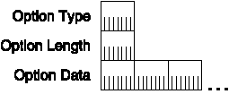
IPv6 extension header
Options format
  Describes a specific characteristic of the packet delivery
  Just for padding

Slide 15
IPv6 extension header
Options format
  Option Type Filed
    third-highest-order bit of the Option Type indicates whether the option data can change (= 1) or not change (= 0) in the path to the destination
Value (Binary) | Action Taken
00 | Skip the option
01 | Silently discard the packet
10 | Discard the packet and send an ICMPv6 ParameterProblem message to the sender if the Destination Address field in the IPv6 header is a unicast or multicast address
11 | Discard the packet and send an ICMPv6 ParameterProblem message to the sender if the Destination Address field in the IPv6 header is not a multicast address

Slide 16


IPv6 extension header
Options category
  Pad1 Option
  PadN Option

Slide 17
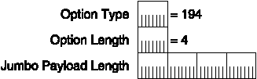
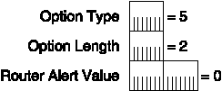
IPv6 extension header
Options category
  Jumbo Payload Option
  Router Alert Option

Slide 18
IPv6 extension header
Options Summary
Option Type | Option and Where It Is Used | Alignment Requirement
0 | Pad1 option: Hop-by-Hop and Destination Options headers | None
1 | Pad1 option: Hop-by-Hop and Destination Options headers | None
194(0xc2) | Jumbo Payload option: Hop-by-Hop Options header | 4n + 2
5 | Router Alert option: Hop-by-Hop Options header | 2n + 0
198(0xc6) | Binding Update option: Destination Options header | 4n + 2
7 | Binding Acknowledgement option: Destination Options header | 4n + 3
8 | Binding Request option: Destination Options header | None
201(0xc9) | Home Address option: Destination Options header | 8n + 6

Slide 19
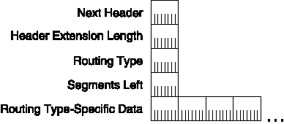
IPv6 extension header
Routing header
  Strict Source Routing
  Loose Source Routing

Slide 20
IPv6 extension header
Routing header
  Routing Header Processing
    Routers that are not mentioned in the source route simply forward the packet without processing the Routing Header
    The current destination address and the address in the (N – Segment Left +1) position in the address list are swapped, where N is total number of addresses in the list
    The “segment left” is decremented
    The packet is forwarded
    When the packet arrives at final destination, the “segment left” is 0

Slide 21
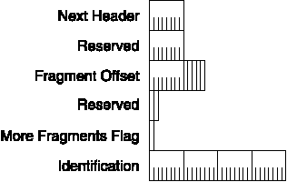
IPv6 extension header
Fragment header
  The Fragment header is used for IPv6 fragmentation and reassembly services

Slide 22
IPv6 extension header
Fragment header
  Fragmentation Process
    The un-fragmental part consists of the IPv6 header, the Hop-by-Hop Options header, the Destination Options header for intermediate destinations, and the Routing header
    The fragmental part consists of the Authentication header, the Encapsulating Security Payload header, the Destination Options header for the final destination, and the upper-layer PDU

Slide 23
IPv6 extension header
Fragment header
  Reassembly Process
    The original payload length is calculated
    The Payload Length field in the IPv6 header for the reassembled packet is updated
    The Next Header field of the last header of the un-fragmental part is set to the Next Header field of the Fragment header of the first fragment

Slide 24
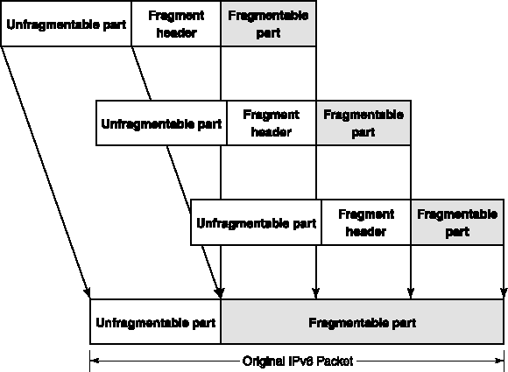
IPv6 extension header
Fragment header
  Reassembly Process

Slide 25
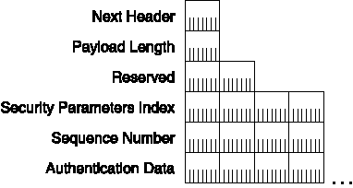
IPv6 extension header
Authentication header
  Data authentication (verification of the node that sent the packet),
  Data integrity (verification that the data was not modified in transit)
  Anti-replay protection (assurance that captured packets cannot be retransmitted and accepted as valid data)

Slide 26
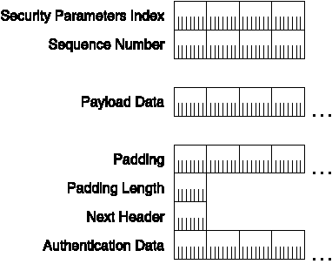
IPv6 extension header
Encapsulating Security Payload header
  Data confidentiality, data authentication, data integrity, and replay protection services to the encapsulated payload

Slide 27
IPv6 MTU & Checksum
IPv6 MTU
  IPv6 requires that the link layer support a minimum MTU size of 1,280 bytes. Link layers that do not support this MTU size must provide a link-layer fragmentation and reassembly scheme that is transparent to IPv6. For link layers that can support a configurable MTU size
IPv6 Checksum
  Source Address, the Destination Address, an Upper Layer Packet Length field that indicates the length of the upper-layer PDU, and a Next Header field that indicates the upper-layer protocol for which the checksum is being calculated

Slide 28
Training course arrangement
Date
Subject
Lecturer
03/10
Introduction to IPv6
Joe Zhao
03/16
IPv6 Addressing
Milo Liu
03/23
IPv6 Header & Extensions
Joe Zhao
03/27
ICMPv6
Feng Zhou
03/30
Neighbor Discovery Protocol
Billy Bian
03/30
Multicast Listener Discovery
Jeffrey Zhou
04/06
Address Autoconfigurator
Feng Zhou
04/06
IPv6 Routing
Milo Liu

Slide 29
Training course arrangement
Date
Subject
Lecturer
04/13
IPv6 Migration Mechanisms
Joe Zhou
04/20
IPv6 Mobility
Milo Liu
Setting Up an IPv6 Test Lab

Slide 30
Q & A

